Slide 1

T
CUAI CS 231n 1팀
2023.05.09
발표자 : 조민서

Slide 2
스터디원 소개 및 만남 인증
이곳에 만나서 찍은 사진을 넣어주세요.
(비대면일 경우엔 화면 캡쳐 이용)
얼굴이 나오게 찍어주셔야 합니다:D
스터디원 1 : 김벼리 (융합공학부)
스터디원 2 : 이혜연 (응용통계학과)
스터디원 3 : 조민서 (소프트웨어학부)

Slide 3
목차
CNN Architectures - AlexNet - VGG - GoogLeNet - ResNet
정리

Slide 4
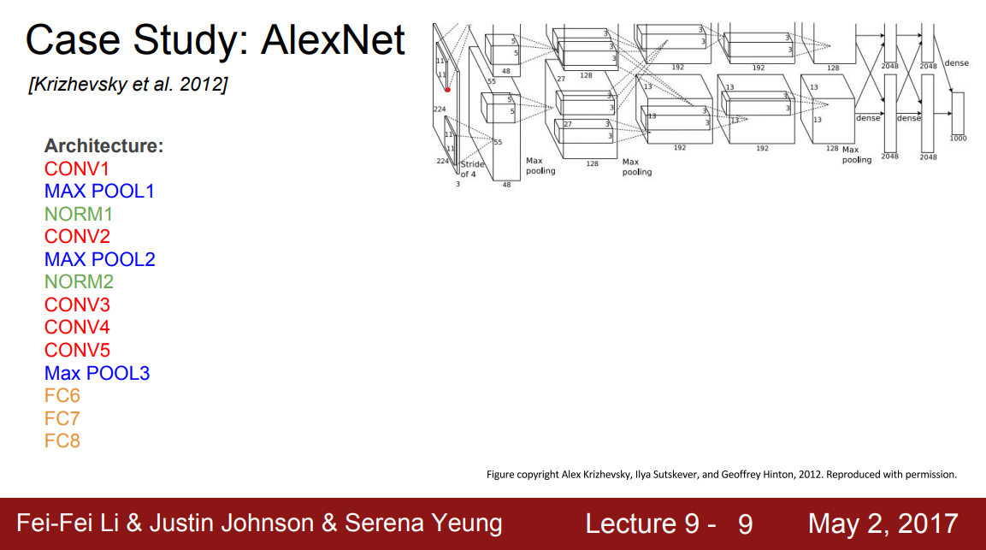
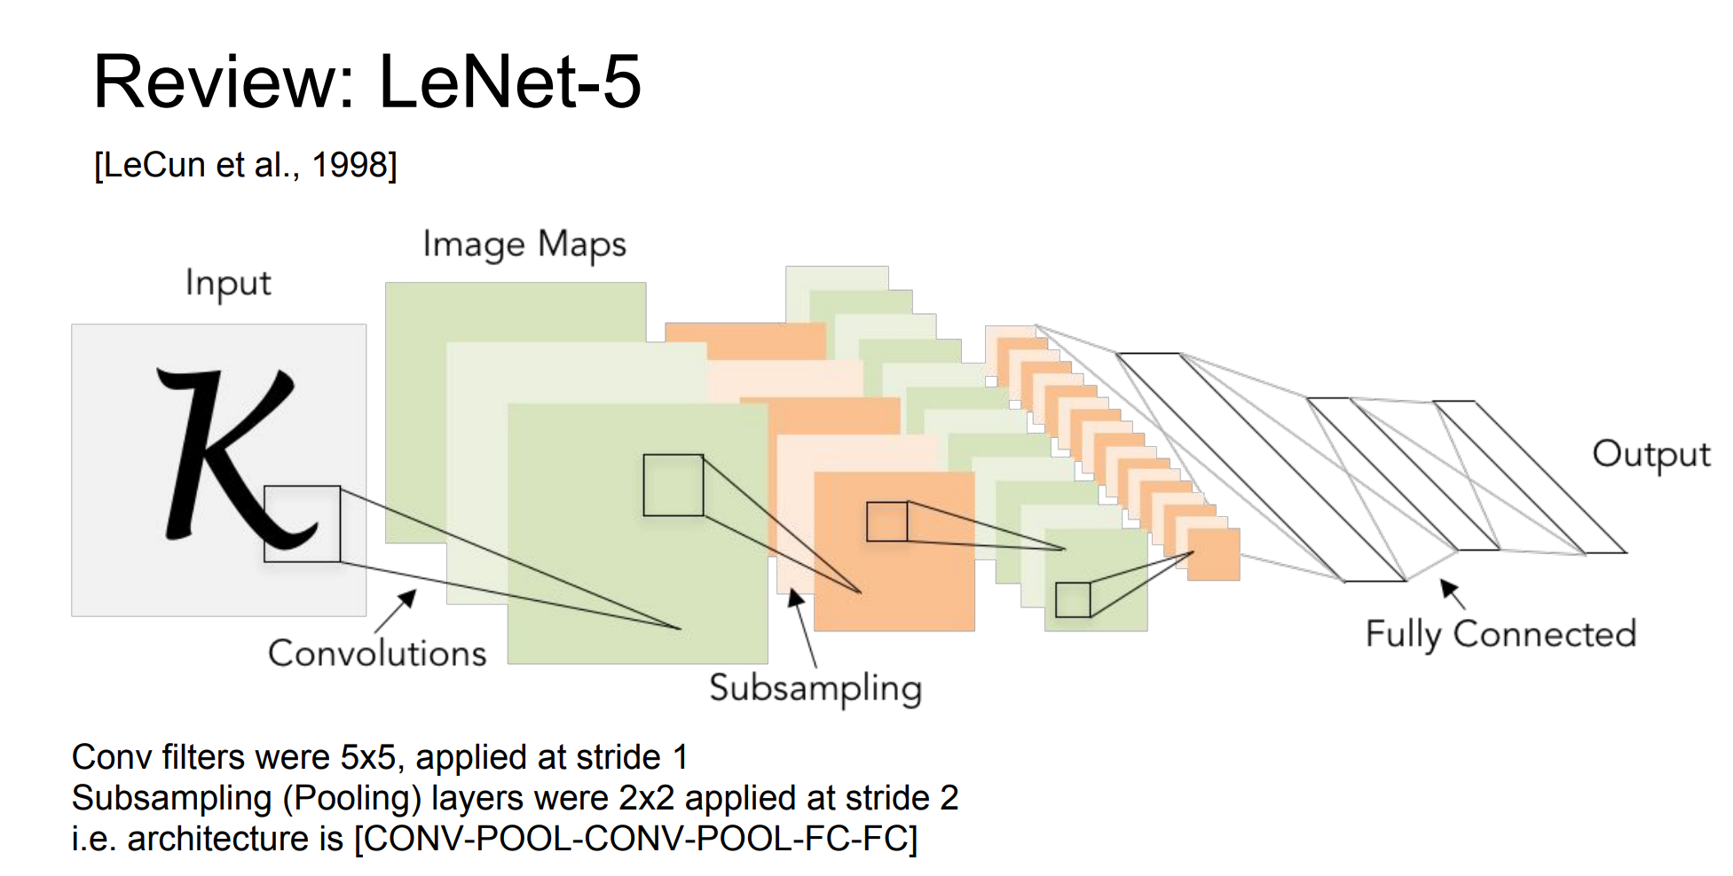
CNN Architectures - AlexNet

Slide 5
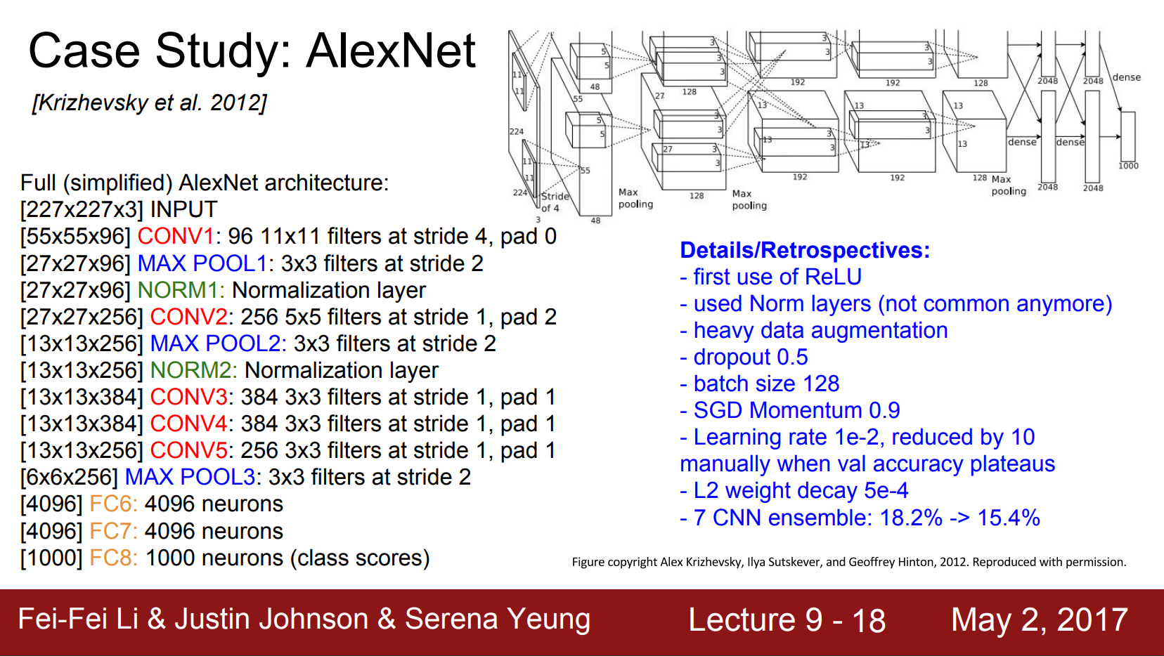
CNN Architectures - AlexNet

Slide 6
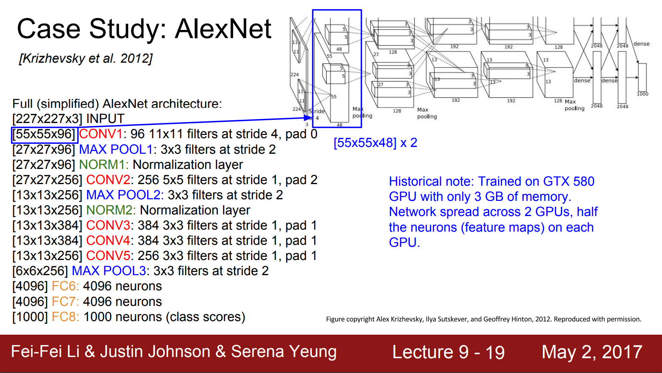
CNN Architectures - AlexNet

Slide 7
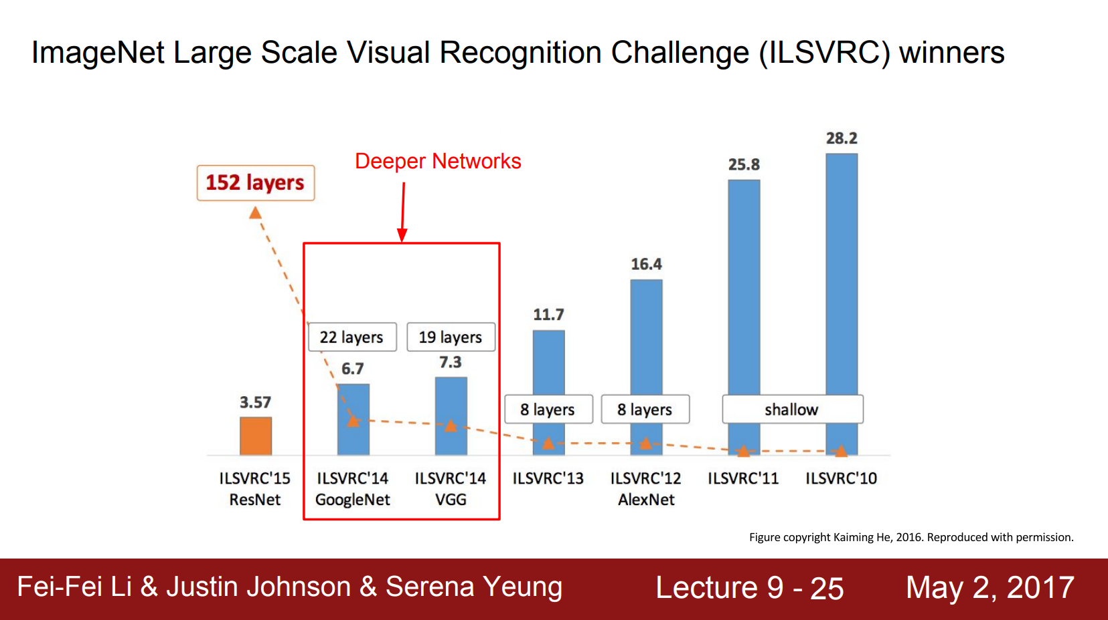
CNN Architectures - VGGNet

Slide 8
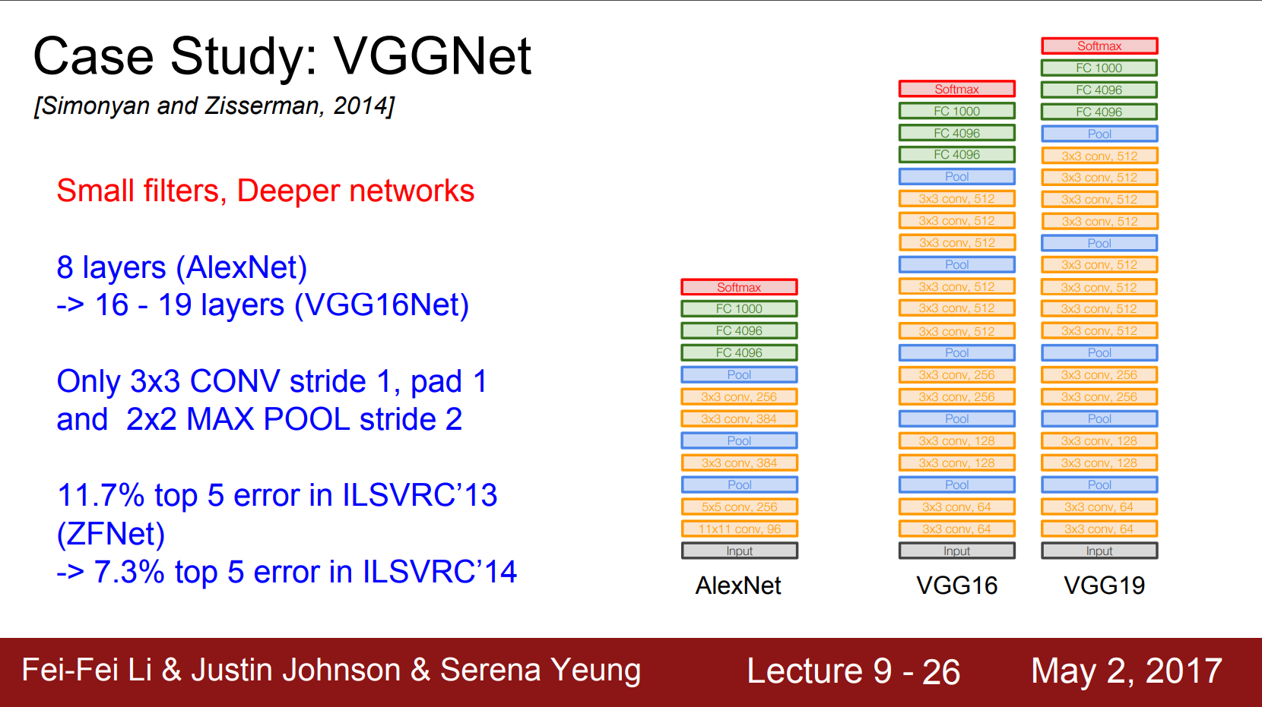
CNN Architectures - VGGNet

Slide 9
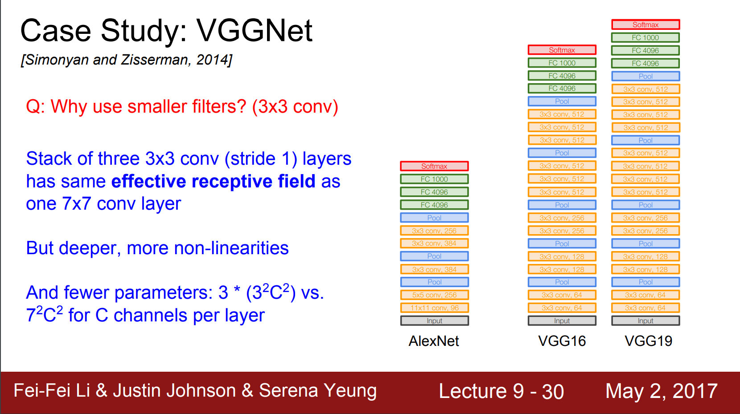
CNN Architectures - VGGNet

Slide 10

CNN Architectures - GoogLeNet

Slide 11
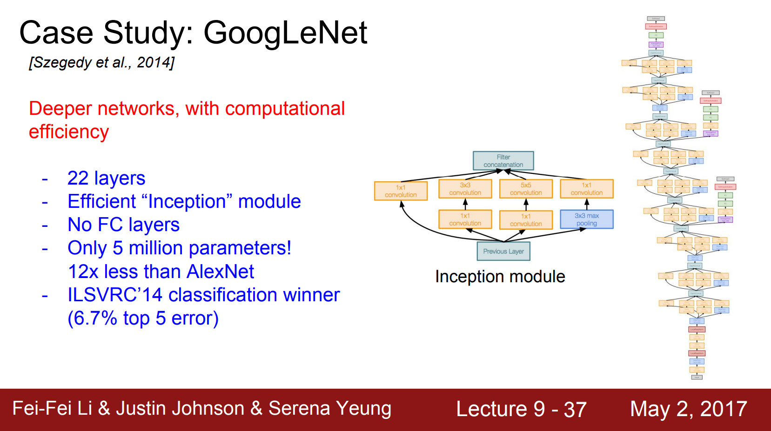
CNN Architectures - GoogLeNet

Slide 12
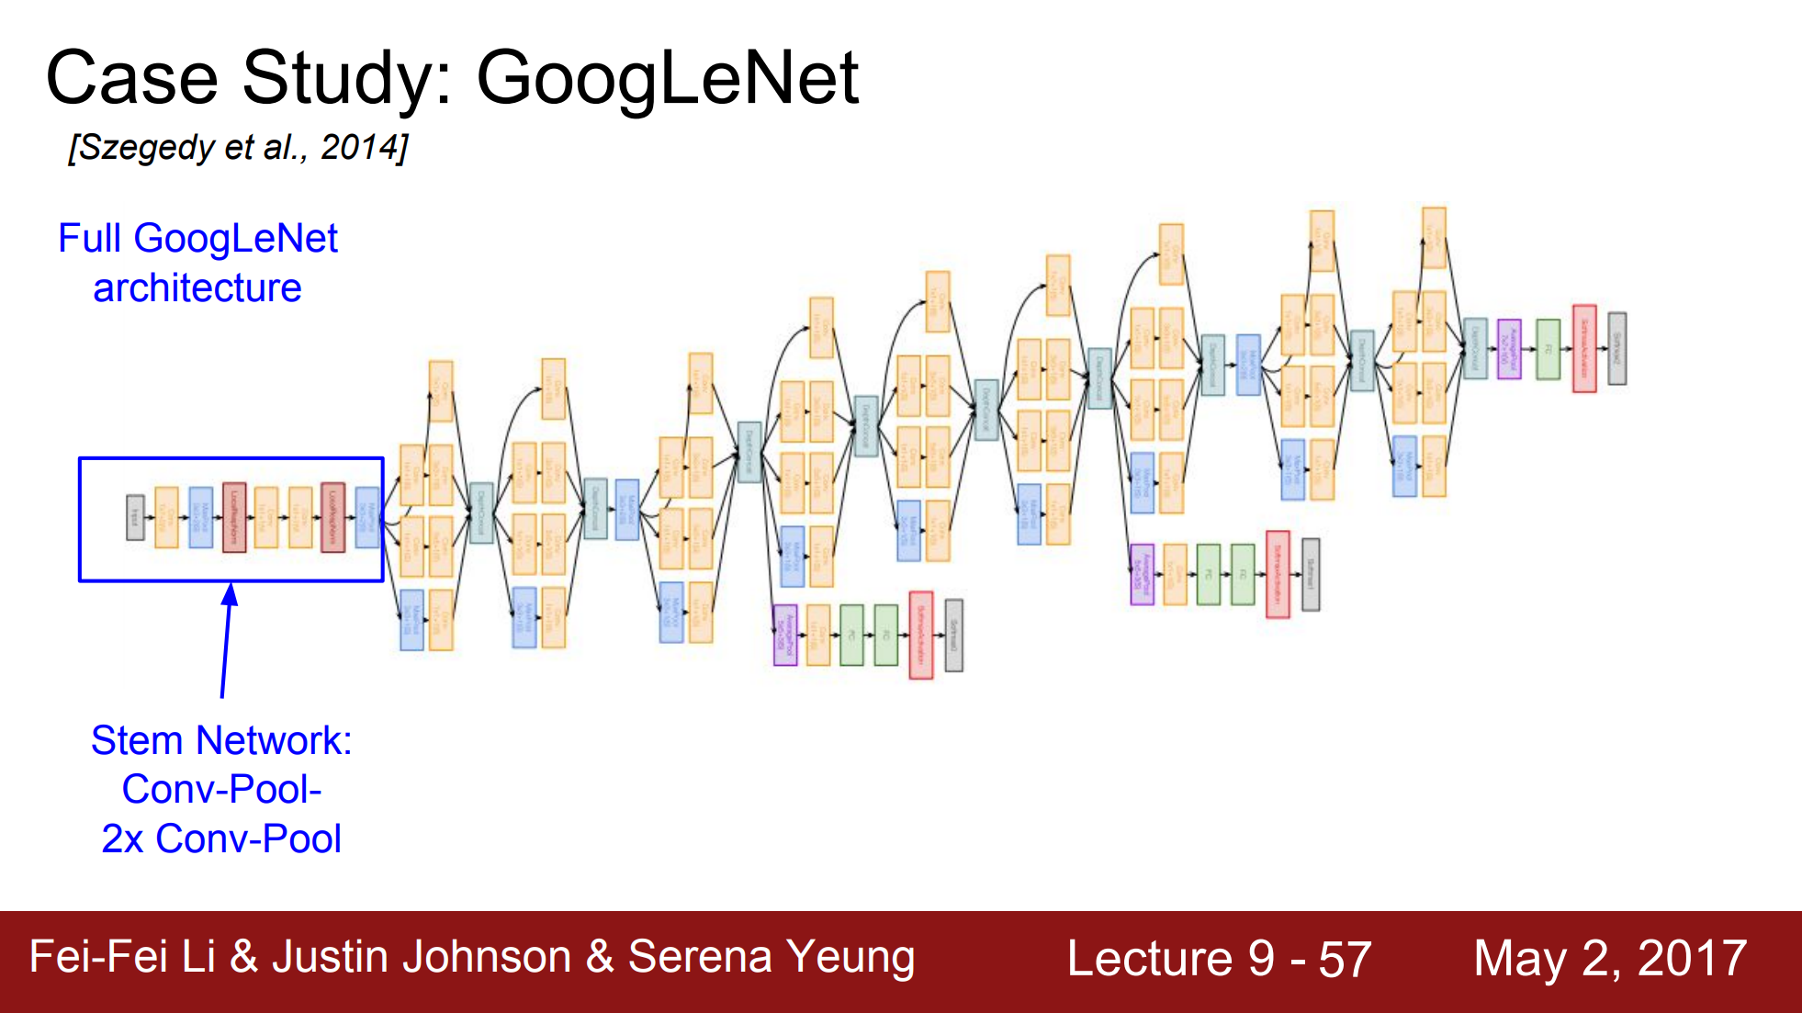
CNN Architectures - GoogLeNet

Slide 13
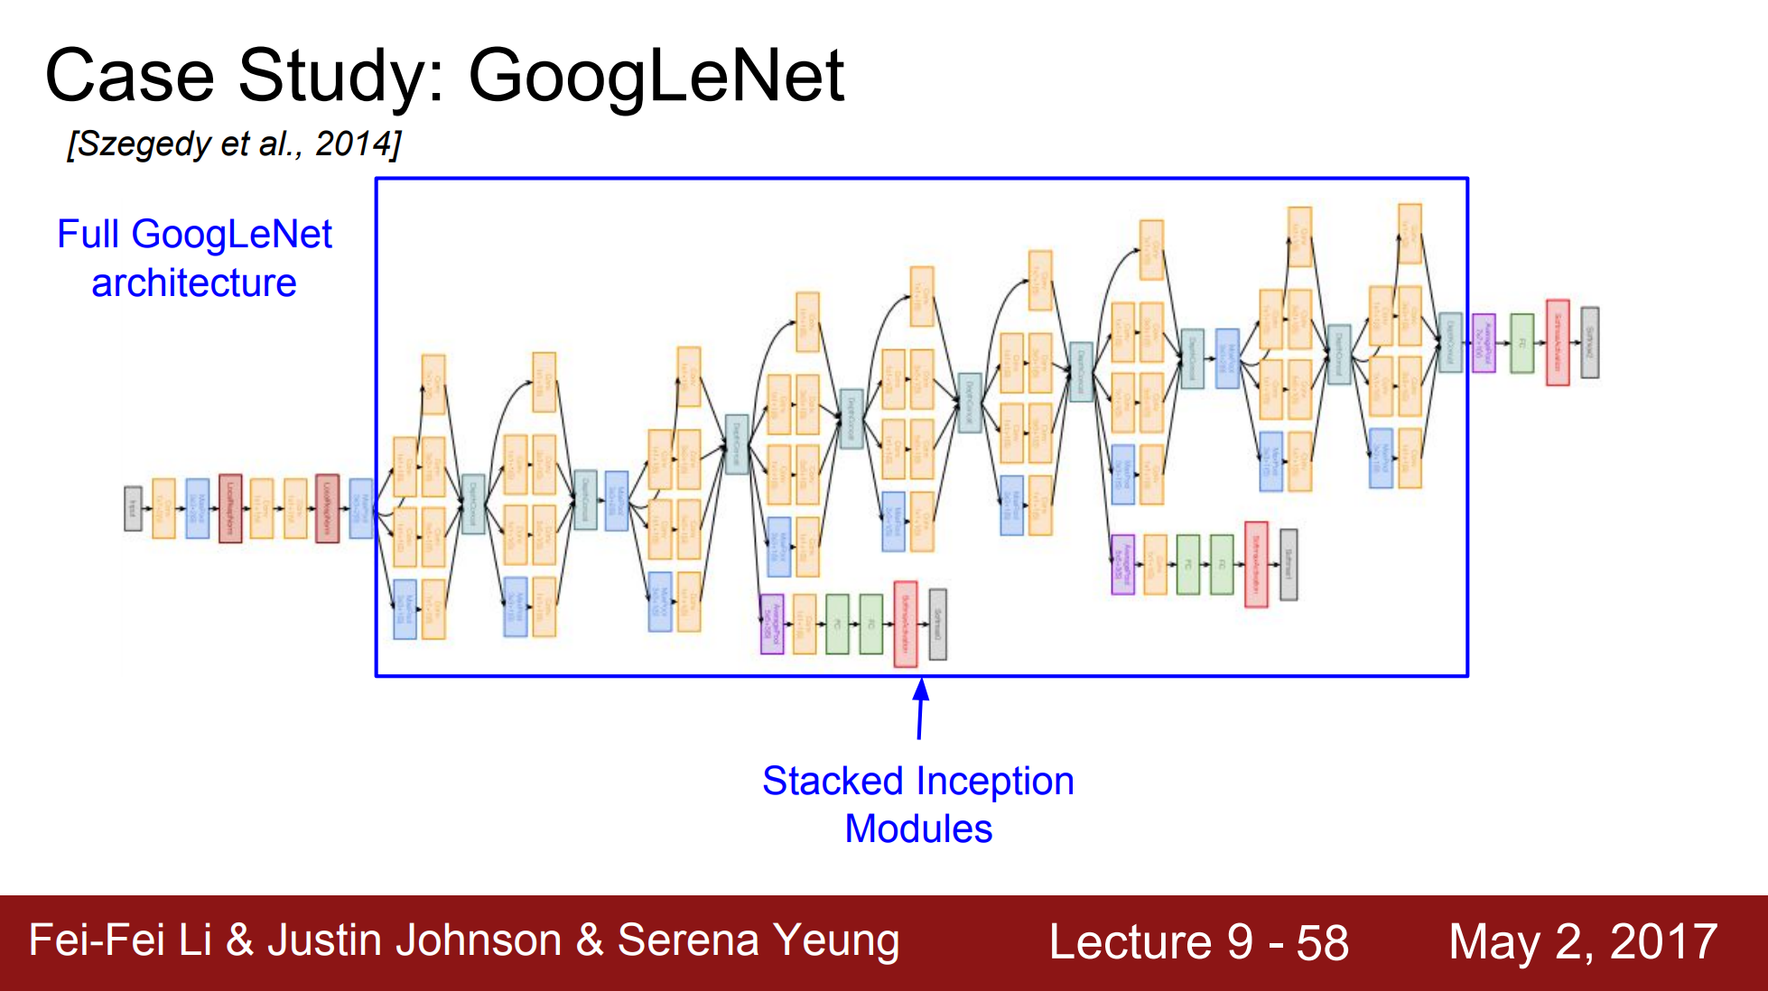
CNN Architectures - GoogLeNet

Slide 14
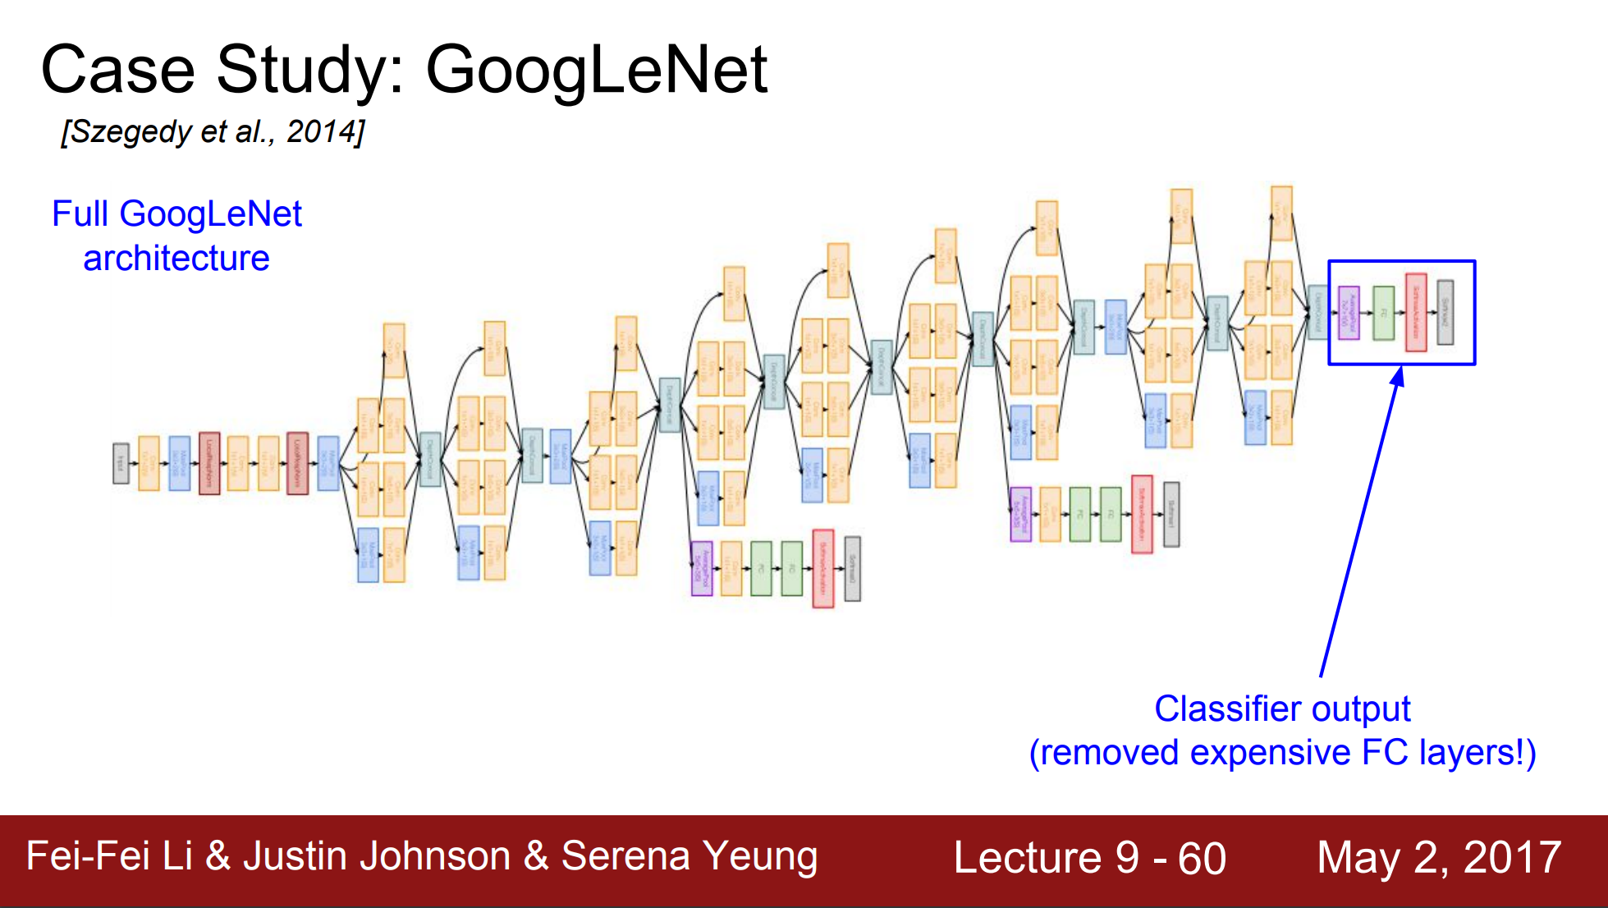
CNN Architectures - GoogLeNet

Slide 15
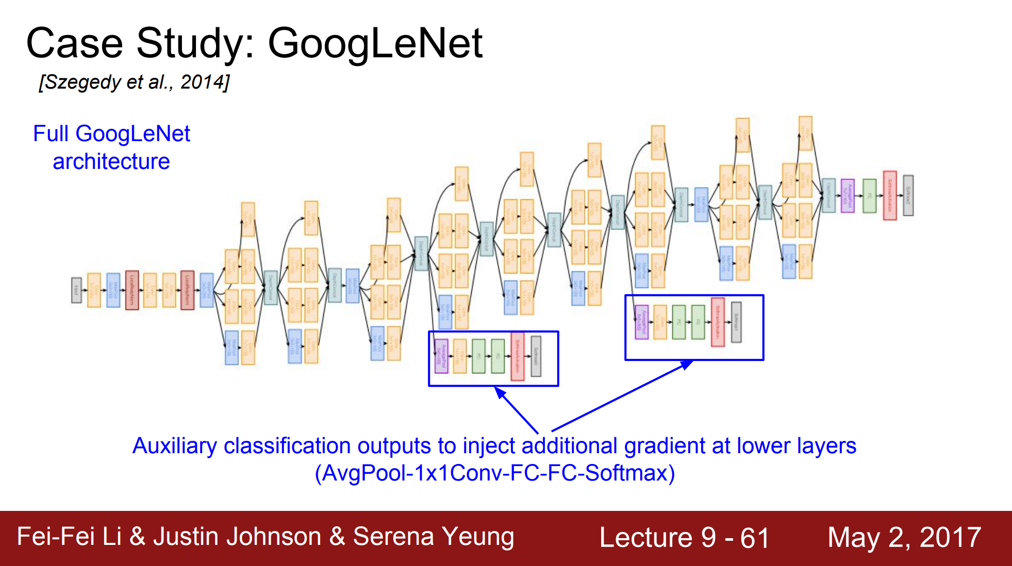
CNN Architectures - GoogLeNet

Slide 16
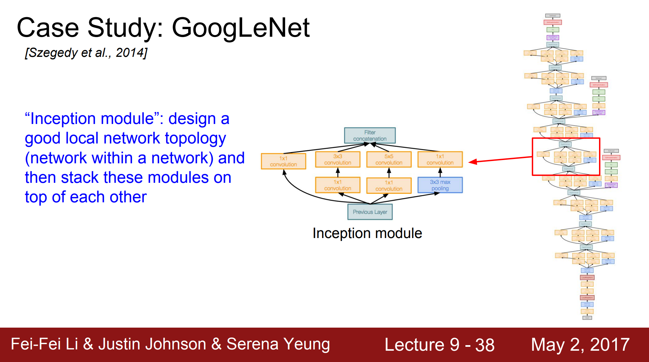
CNN Architectures - GoogLeNet

Slide 17
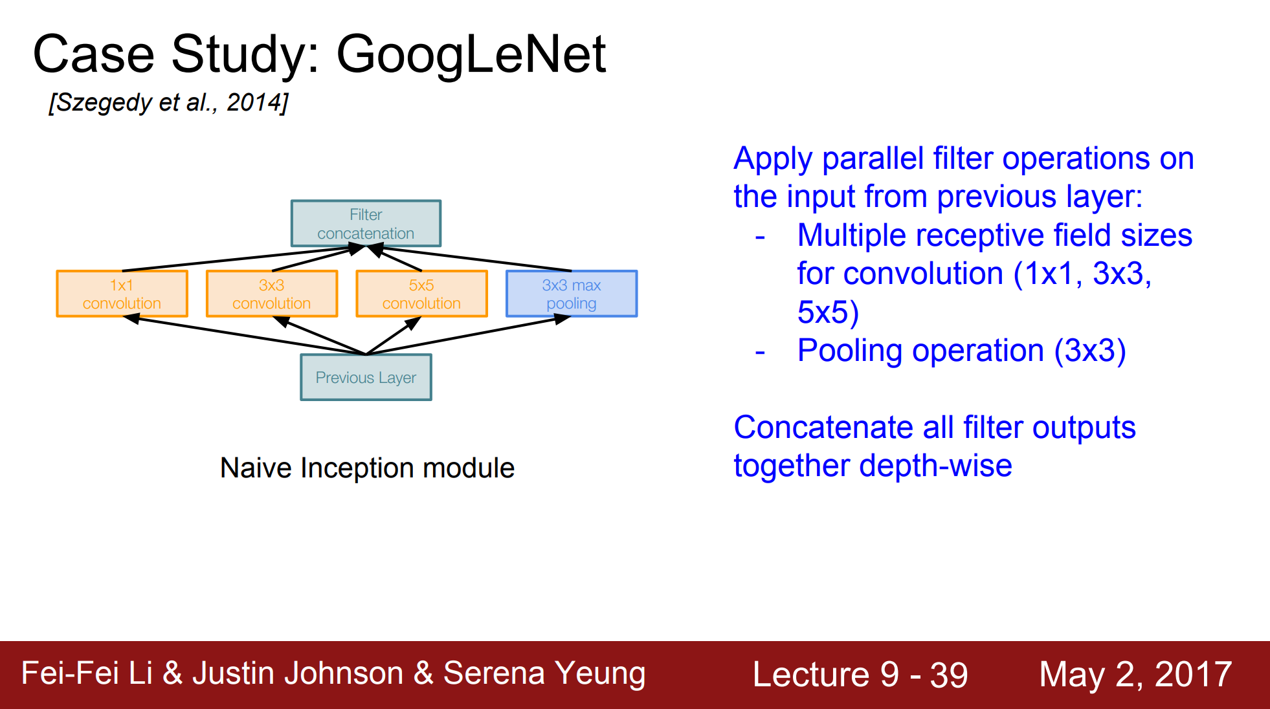
CNN Architectures - GoogLeNet

Slide 18
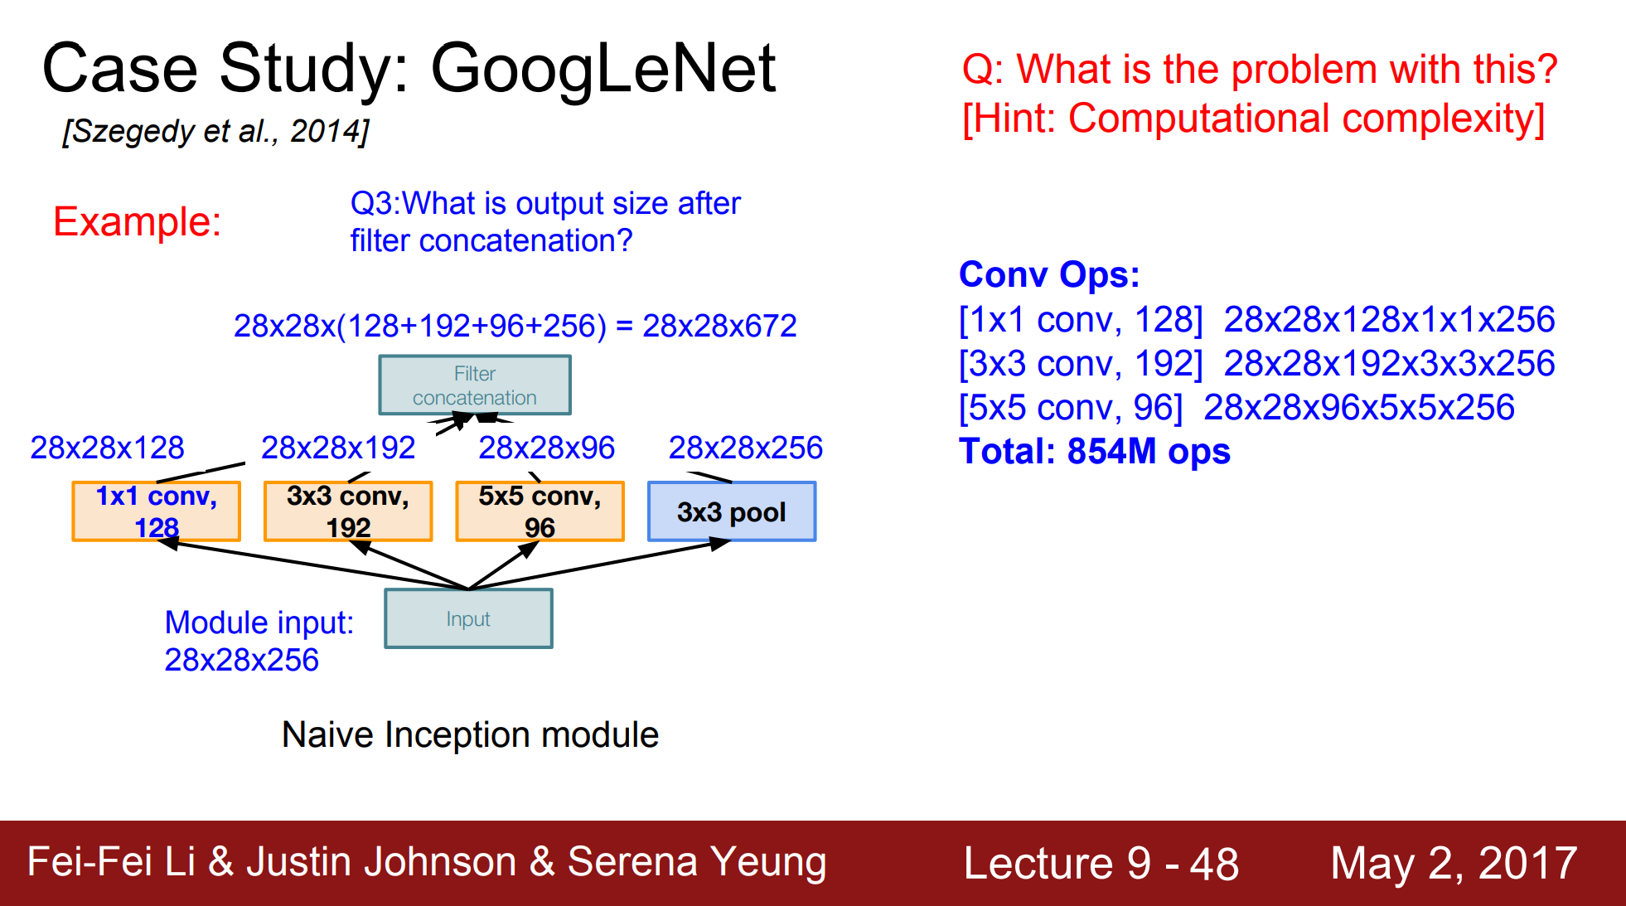
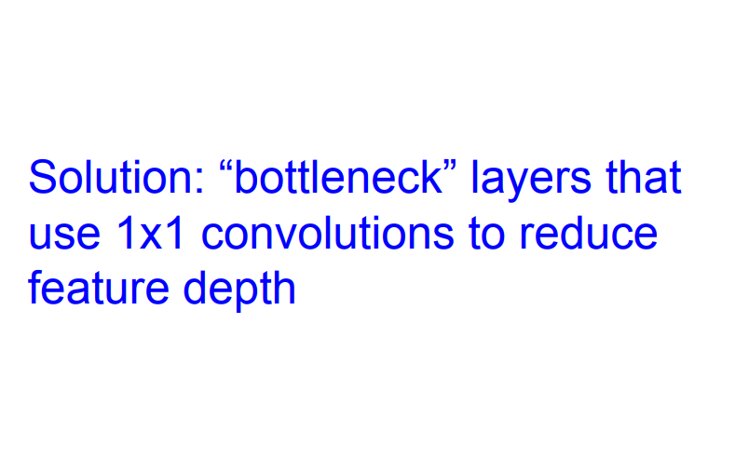
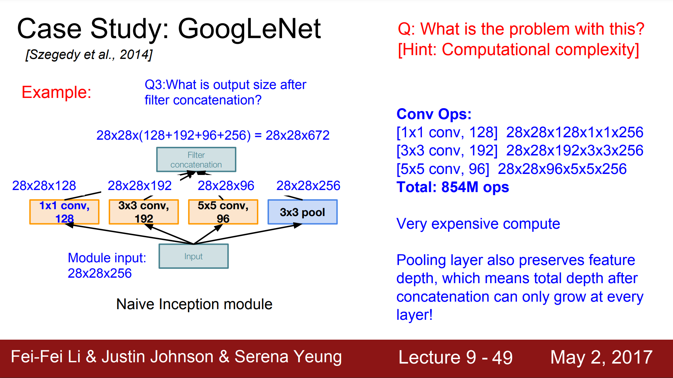
CNN Architectures - GoogLeNet

Slide 19
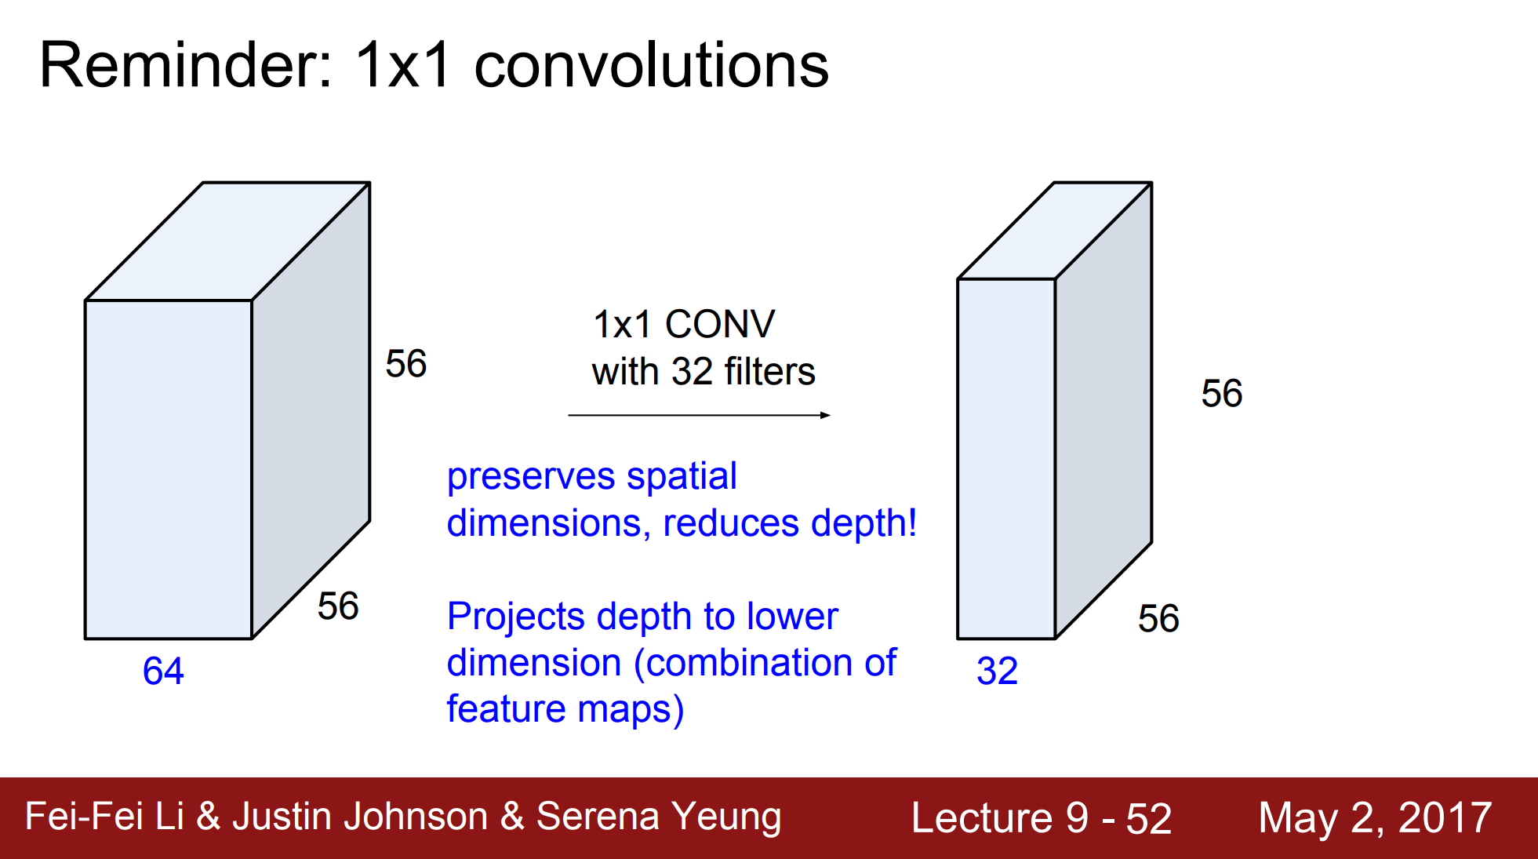
CNN Architectures - GoogLeNet

Slide 20
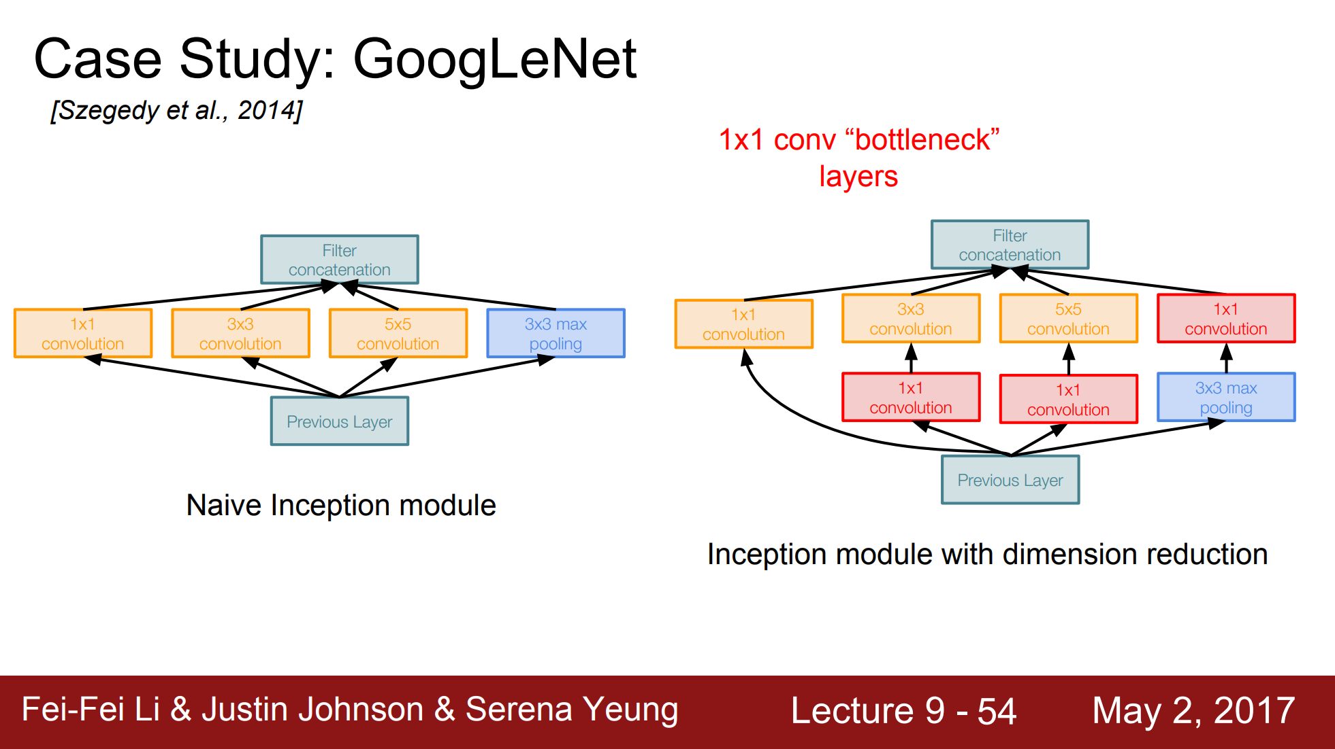
CNN Architectures - GoogLeNet

Slide 21
CNN Architectures - GoogLeNet

Slide 22
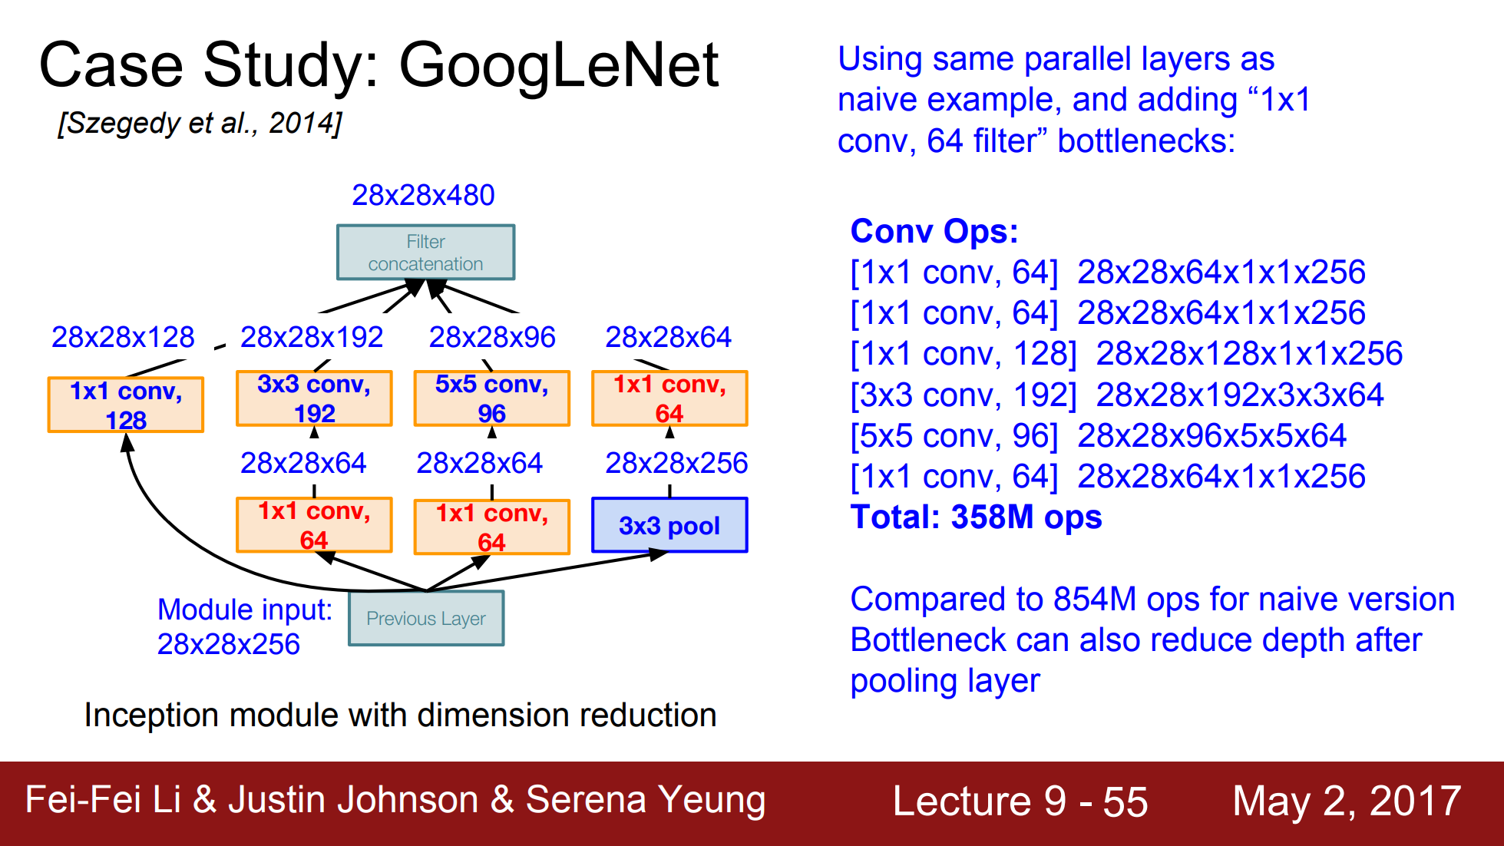
CNN Architectures - GoogLeNet

Slide 23
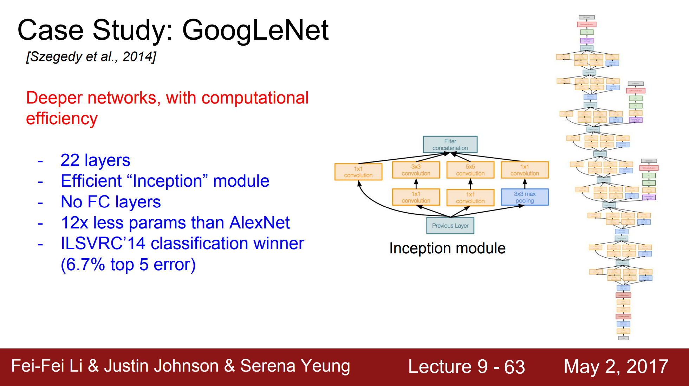
CNN Architectures - GoogLeNet

Slide 24
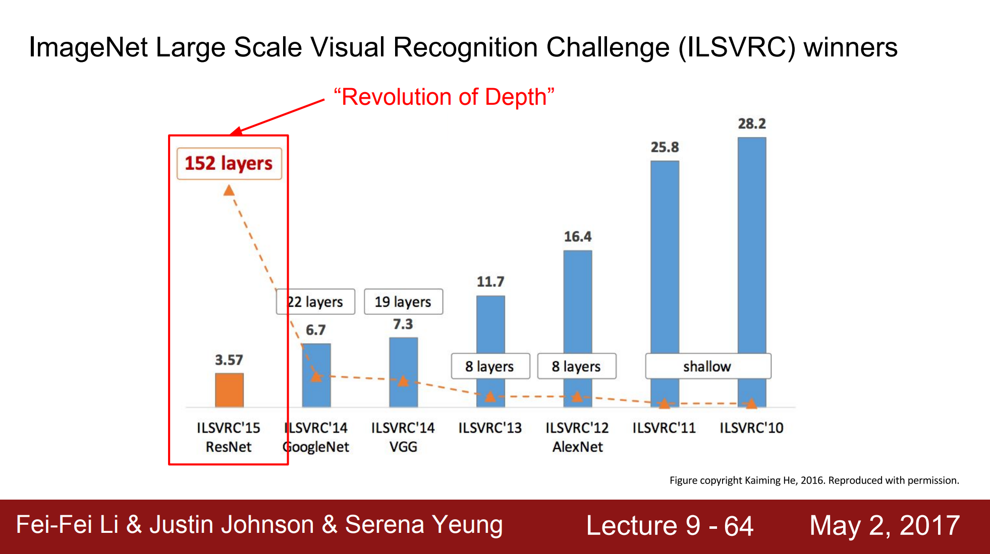
CNN Architectures - ResNet

Slide 25
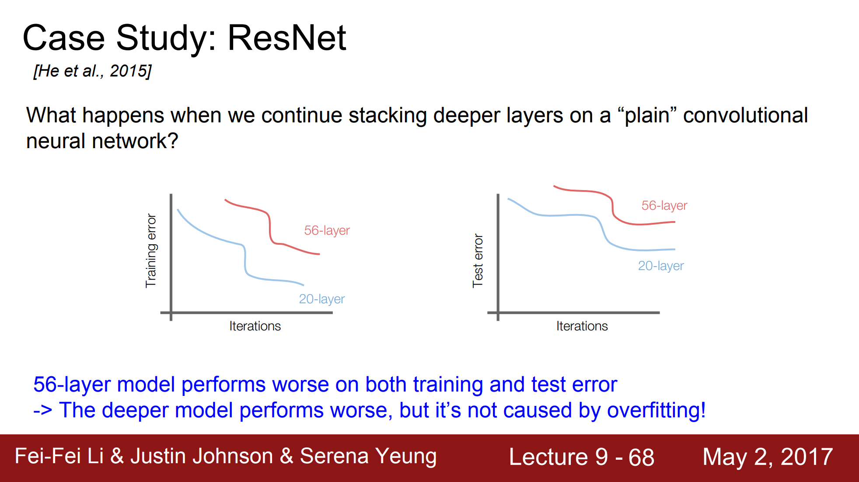
CNN Architectures - ResNet

Slide 26
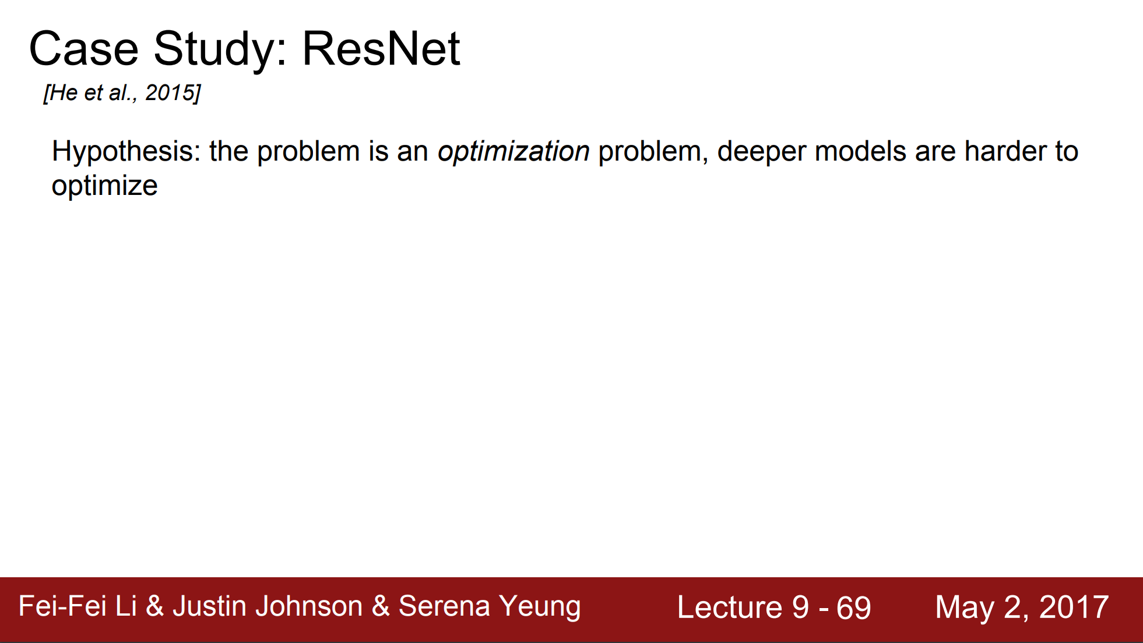
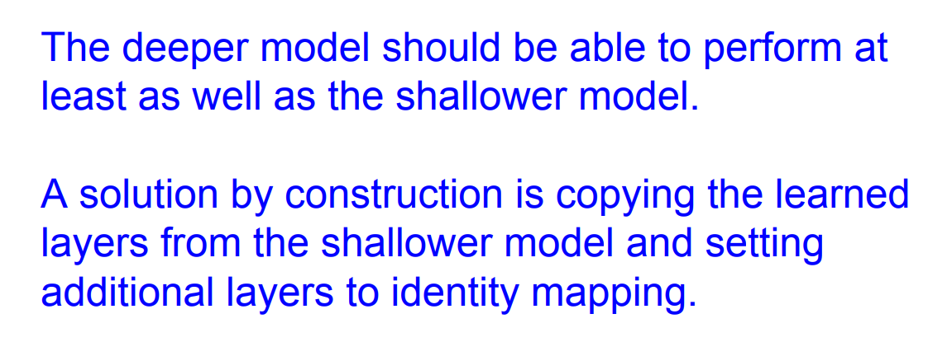
CNN Architectures - ResNet

Slide 27
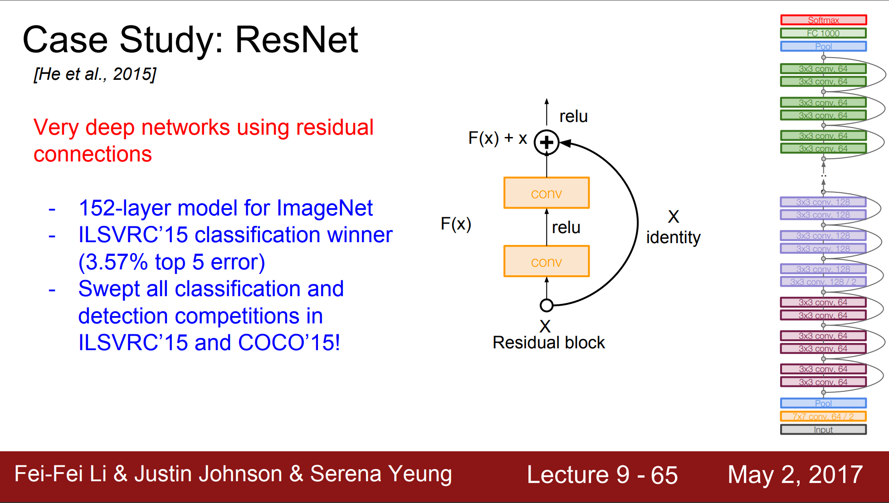
CNN Architectures - ResNet

Slide 28
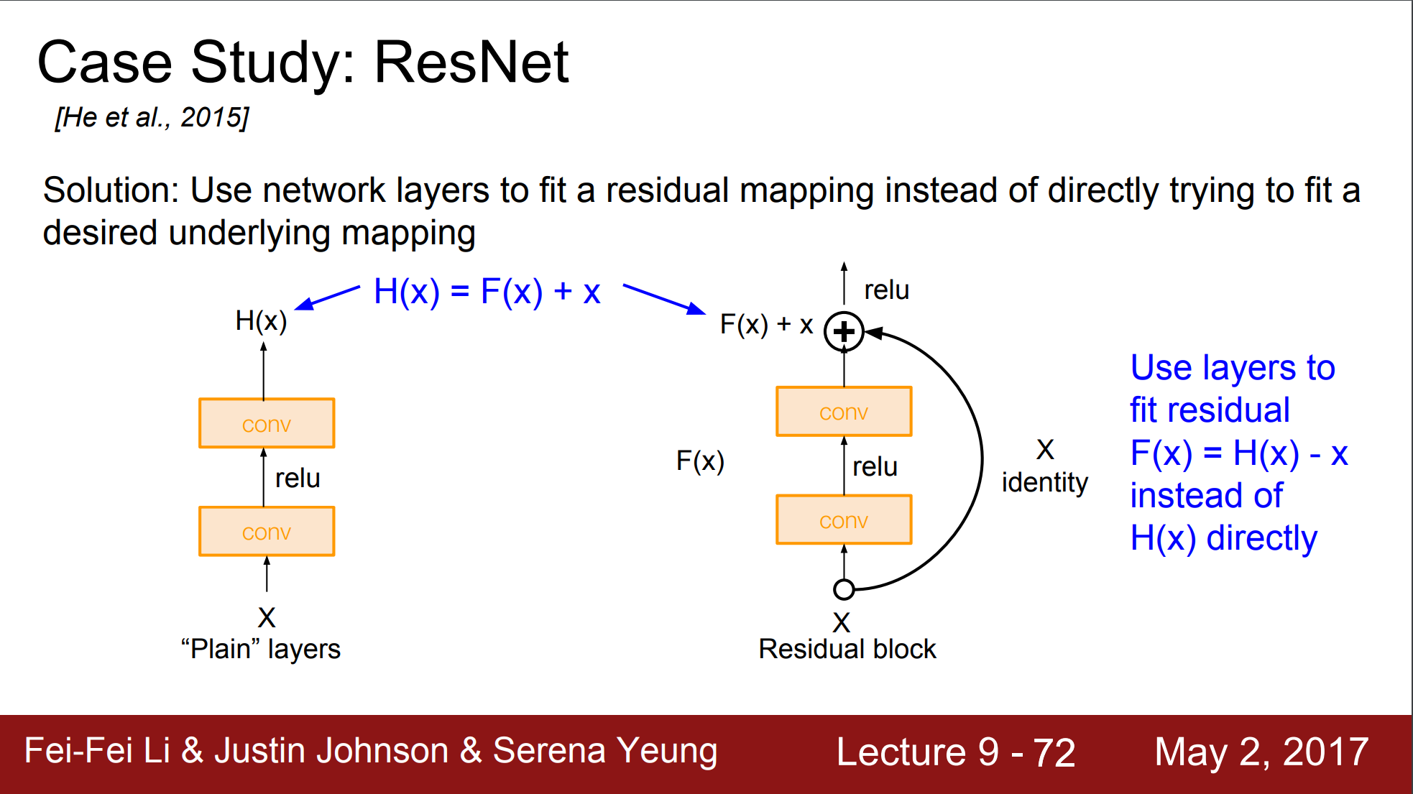
CNN Architectures - ResNet

Slide 29
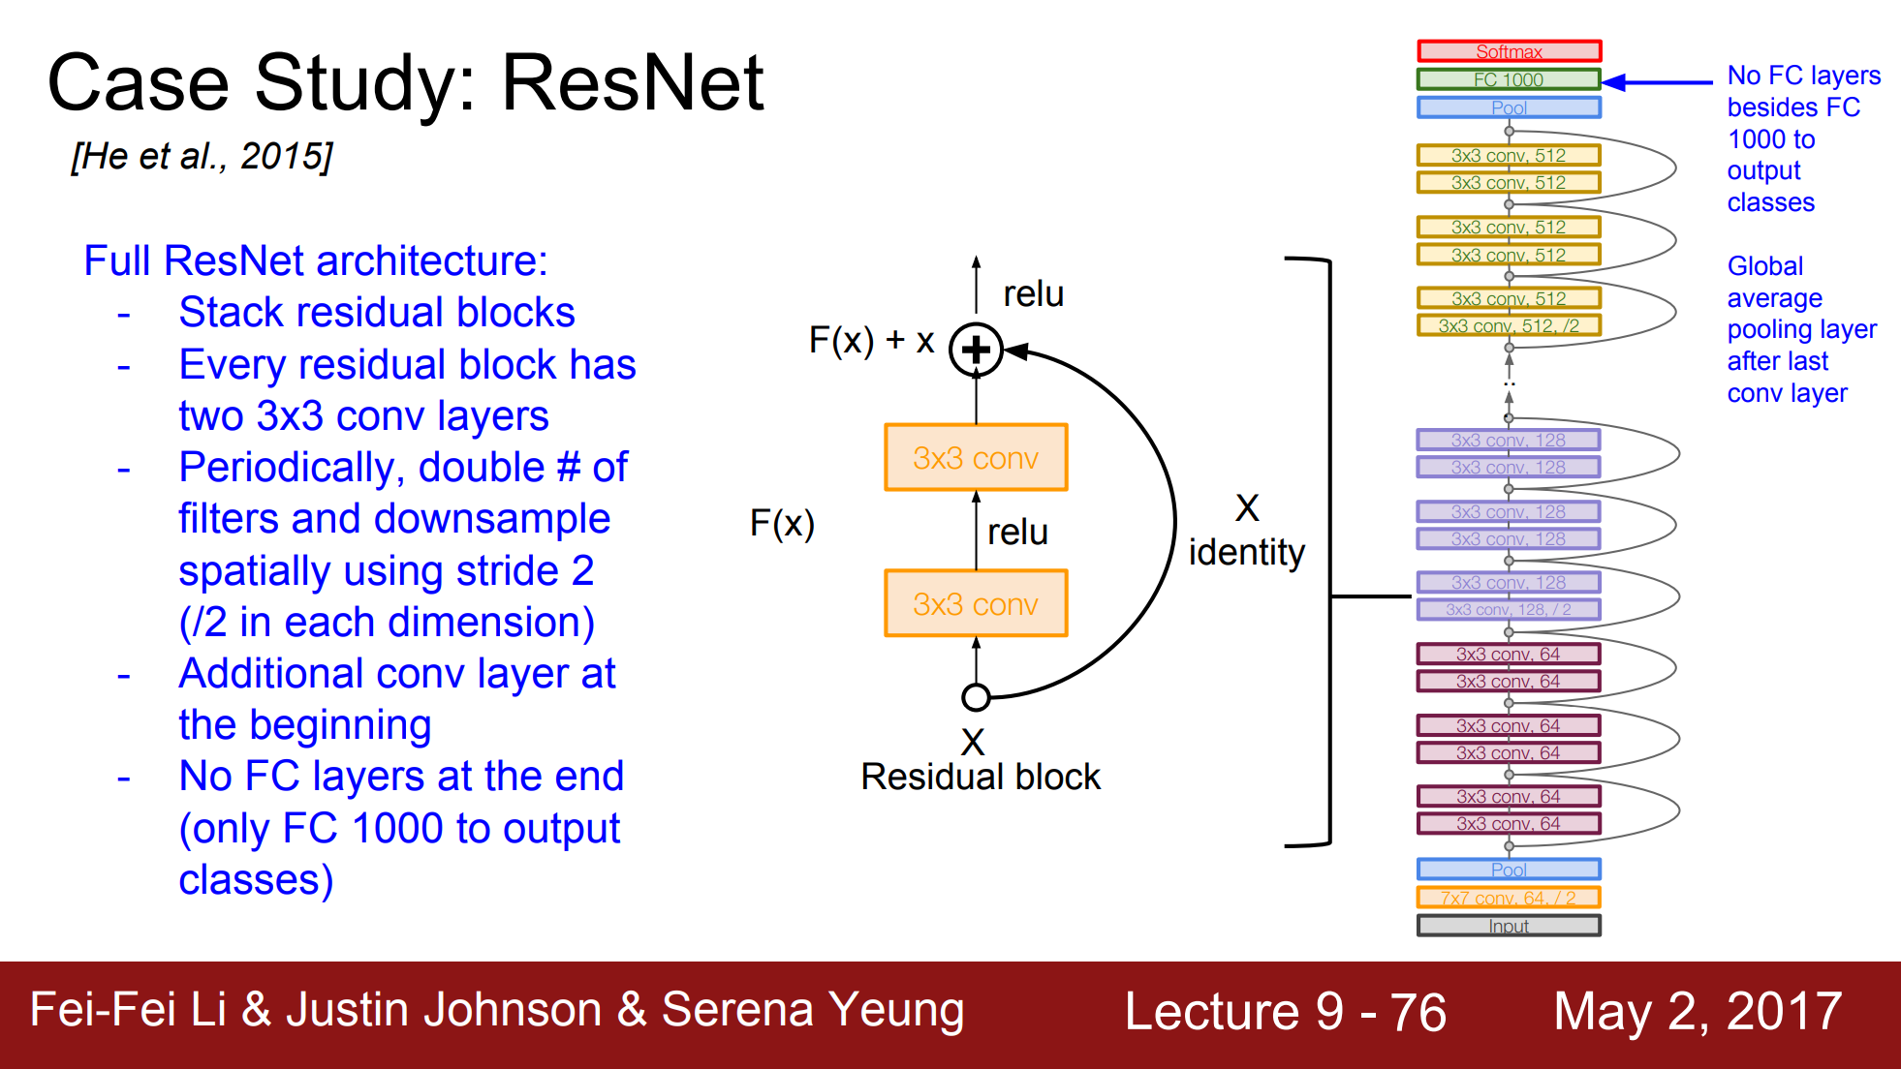
CNN Architectures - ResNet

Slide 30
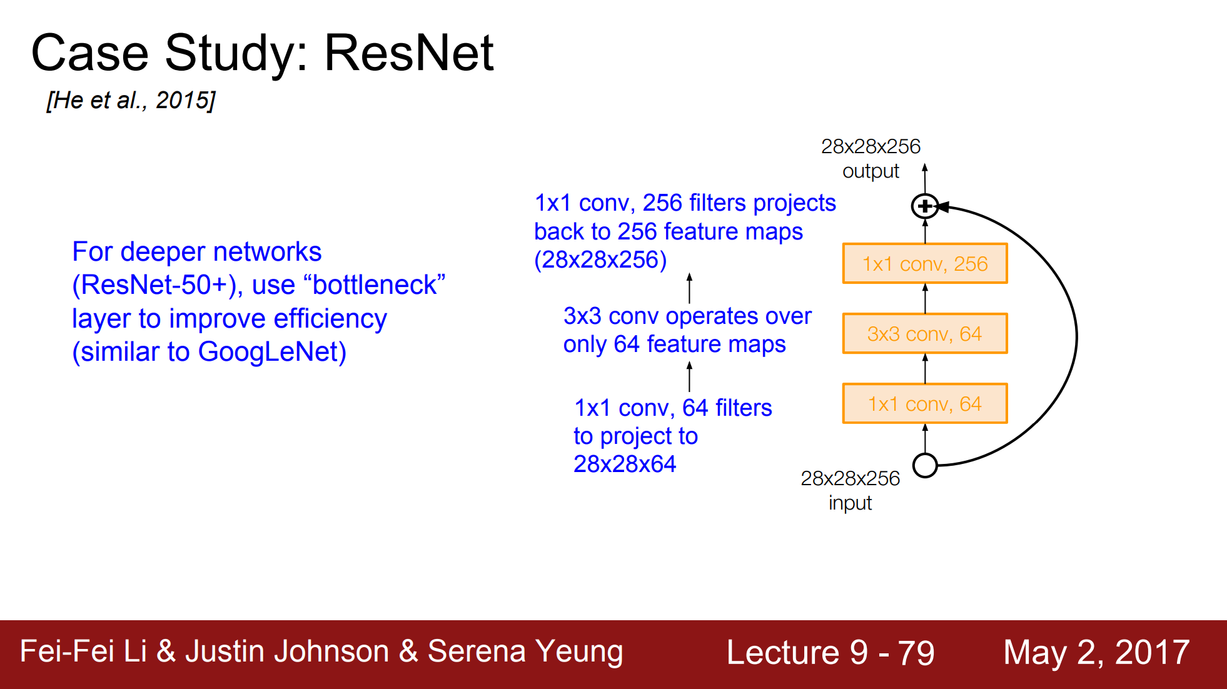
CNN Architectures - ResNet

Slide 31
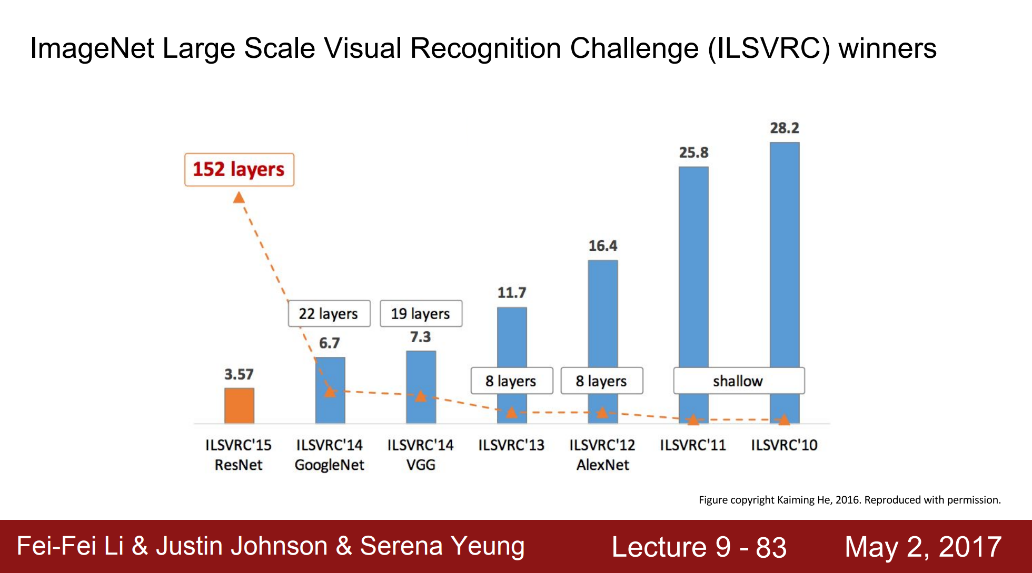
2. 정리

Slide 32
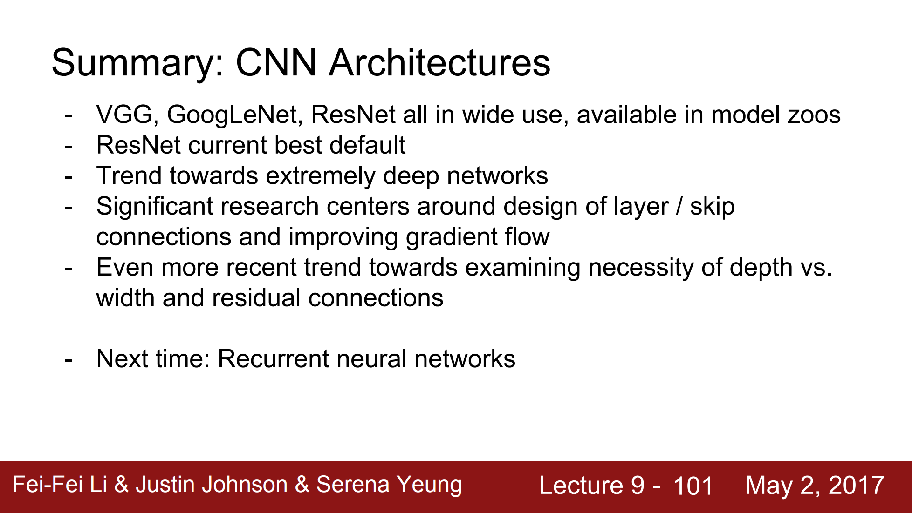
2. 정리

